Slide 1
Better Management of Bicycle Fleet - BikeShare

Slide 2
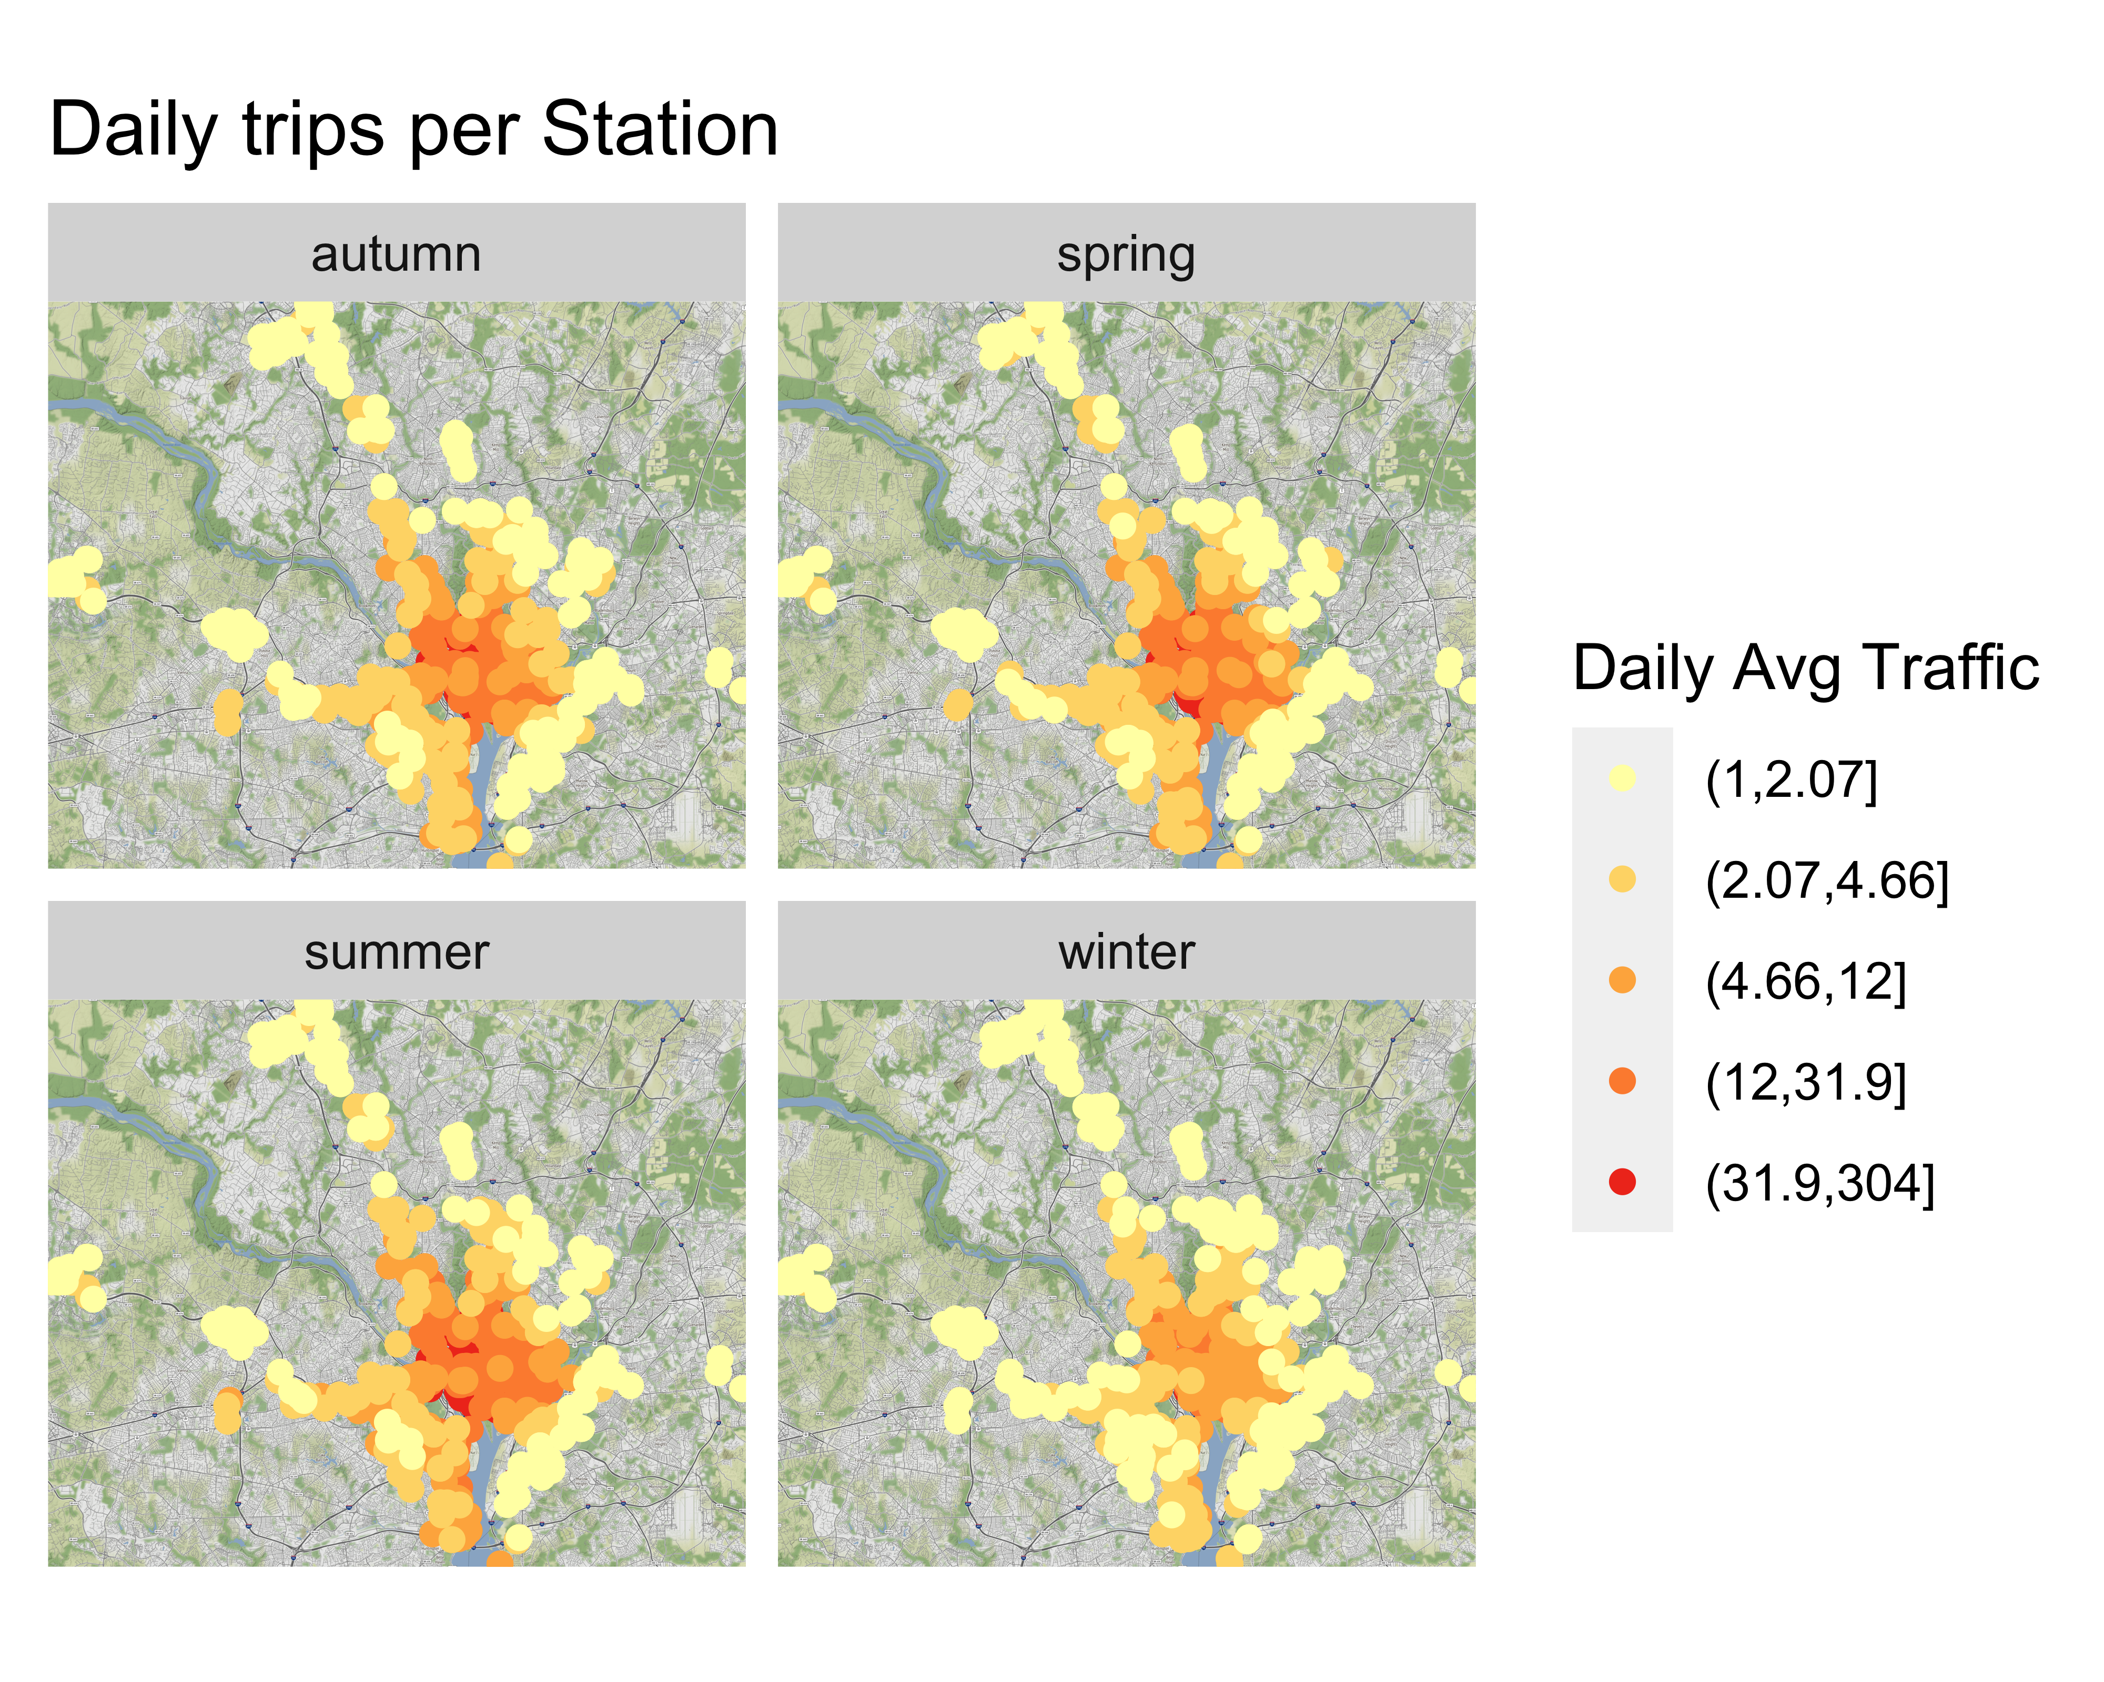
Introduction and Purpose
As the Council-owned bike sharing scheme for the City, BikeShare has the mission to provide a reliable, cost-effective bicycle sharing service across the Metropolitan area. In 2017 alone, BikeShare served over 3.8 % million trips with a fleet of 4,652 bicycles.
As of today, bike repairs only occur when a bike is detected broken. Apart from the obvious impact on customer satisfaction when a bike breaks, this model is also inefficient from a workshop’s workload perspective, affecting workload and time to repair.
In order to address, this BikeShare can tap into the existing operational data and use analytics to optimise this problem.

Slide 3
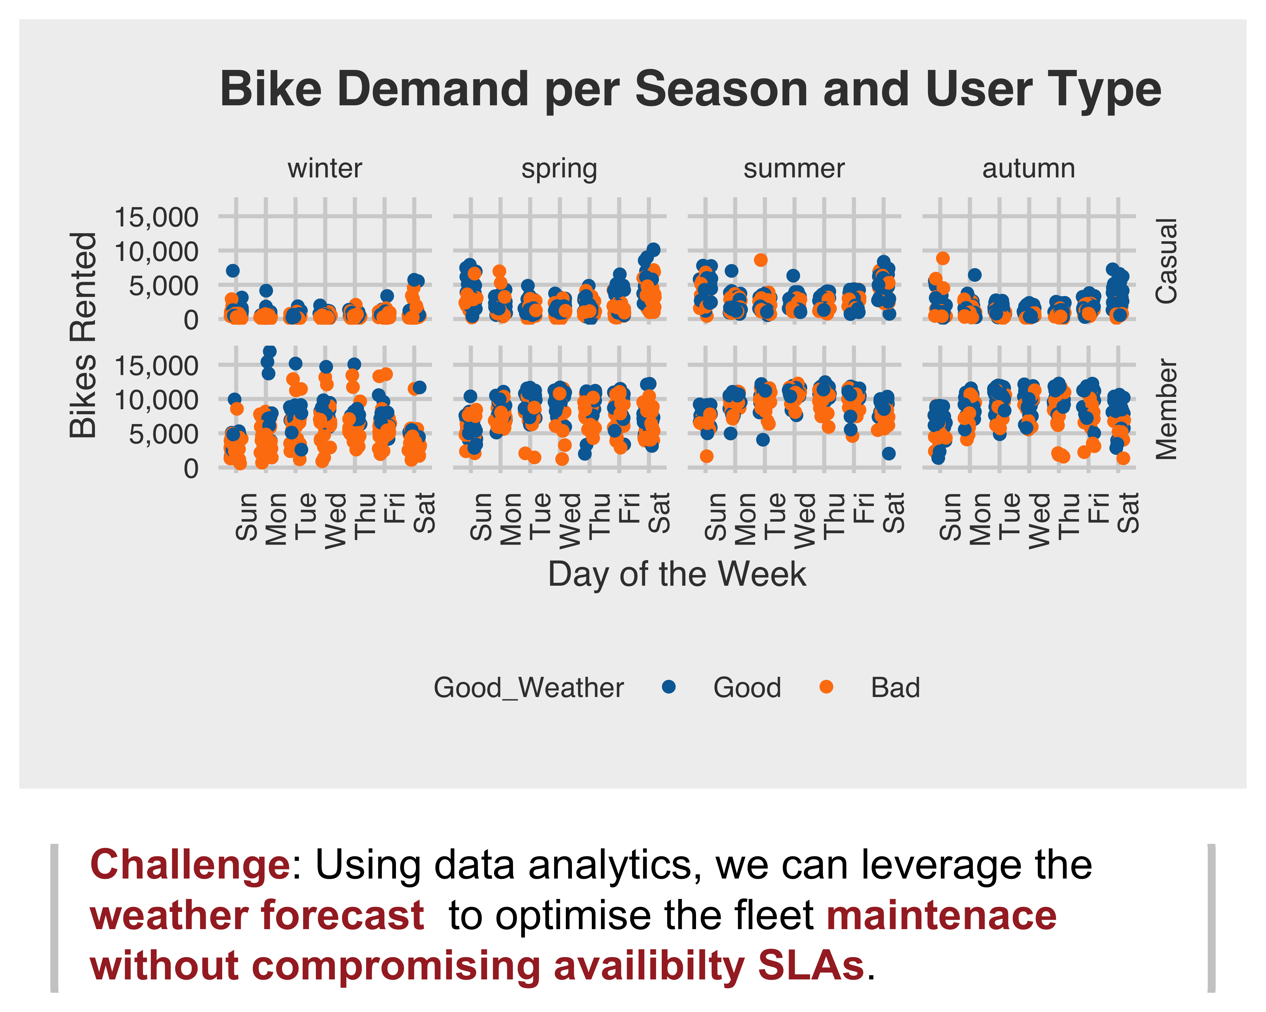
Fleet maintenance volumes and windows need to be carefully chosen
In order to provide a good service for the users of the bike sharing scheme, unavailability needs to be avoided. Unavailability is caused by lack of maintenance or lack of supply. Thus, maintenance windows need to be selected smartly.
Shared bikes are used every day of the week. Registered users provide a constant demand baseline.
There is some seasonality in the demand: registered users brave through the winter keeping the numbers high.
At first look, it seems that weather conditions are the biggest deterrent for bike usage. If it is too cold, or too hot or too windy casual users won’t ride; registered users’ numbers will also drop.
Bikes will keep breaking - even if they are well built! Thus, every opportunity to undertake maintenance needs to be taken.

Slide 4
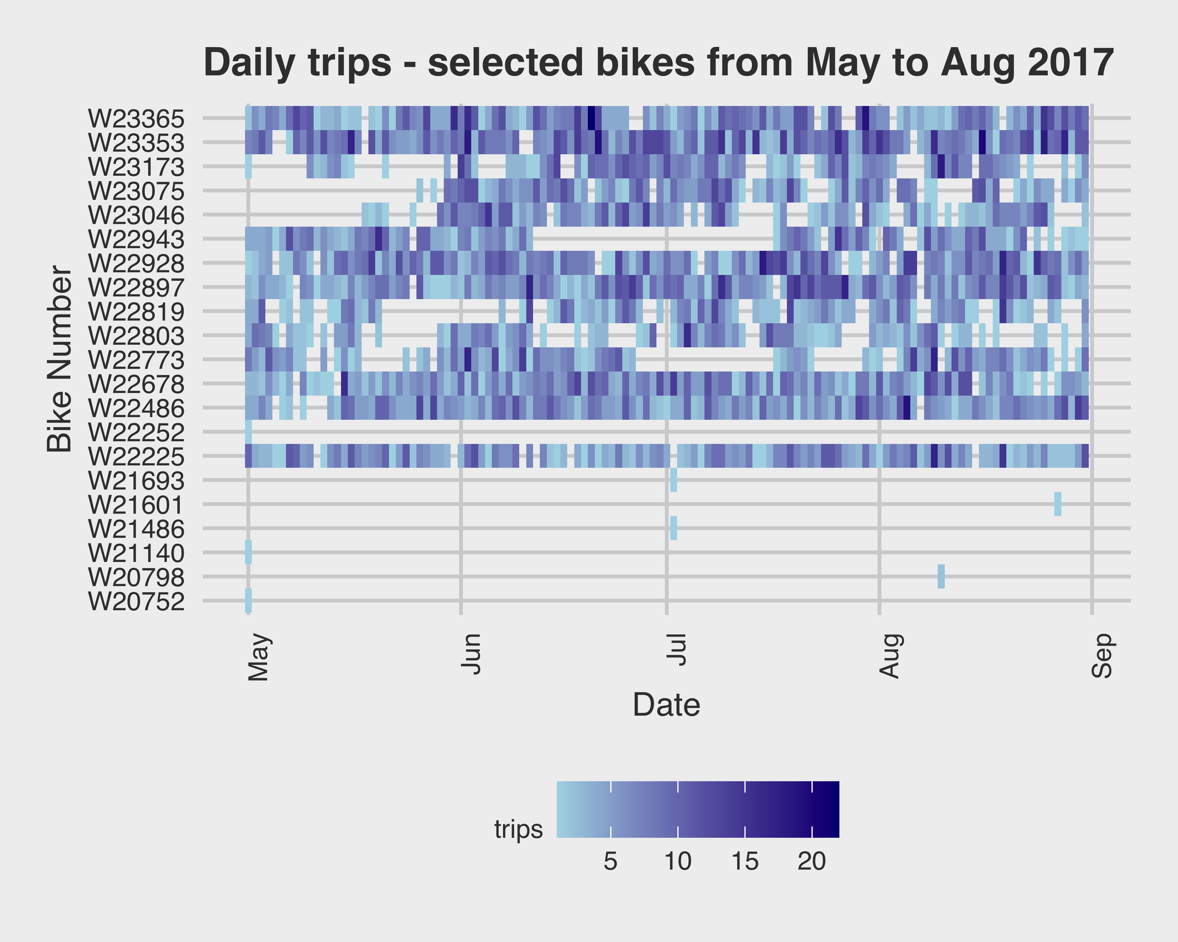
By addressing uneven bike utilisation, it is possible to extend the life of the fleet
Some bicycles in the fleet are heavily used almost every single days, while others are seldomly ridden. As a result:
Heavily used bikes will be at higher risk of failure and accelerated asset ageing.
Unused bikes will be at risk of neglect - e.g. left with flat tyres in an low traffic station.
By obtaining a detailed log of all bike travel, it will be possible to identify which bikes are being used the most and calculate their risk of failing. This will allow to proactively book them for service.
When those bike are taken out for service, they can be replaced with lower used bikes , evening asset utilisation.

Slide 5
Data Collection to Optimise Maintenance workload and bike availability
To achieve the objectives, the below data needs to be collected:
Detailed trip data, itemised per each trip taken by each bicycle
Weather Observations/Forecast for each day of the year
Bike failure rates.
Workshop’s repair turnaround stats.
Based on the data, the below metrics will be generated:
Metric | Description | Source
Daily Service Capacity | Number of bikes that can be maintain any day, based on workshop capacity and predicted demand | Workshop Turnaround stats, Summary of daily trip data, weather
Need to Service Factor | Indicator whether a bike needs service ahead of probable failure | Detailed trip data
These metrics (combined with spontaneous failure rates) should serve as input for a proactive service plan.

Slide 6
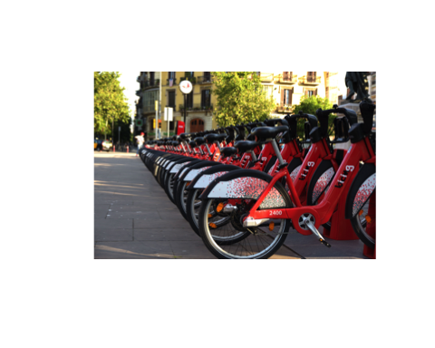
Next Steps
The next steps on this journey are:
Source all missing data.
Collect all data.
Conduct analysis and try different models.
Present results.

